Slide 1
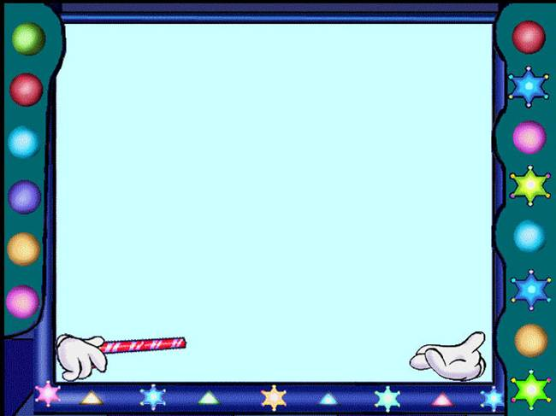
like doing 的用法
小学深港版 英语五年级
翠北实验小学 刘艳

Slide 2
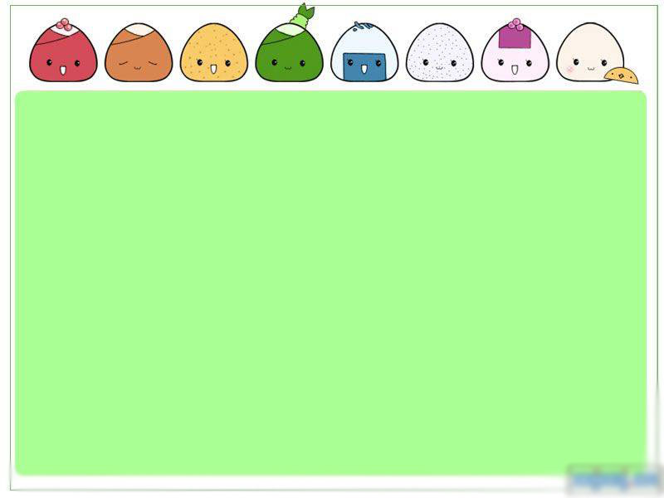
like doing的肯定、否定用法。
Exercises

Slide 3

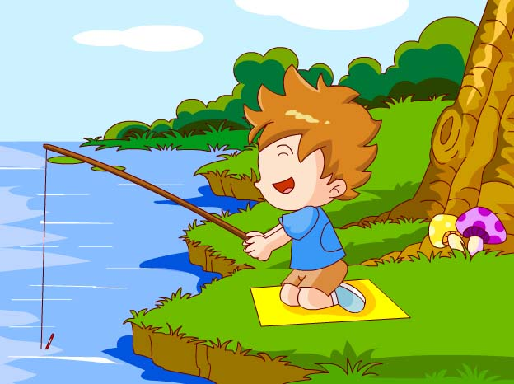
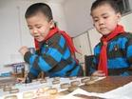
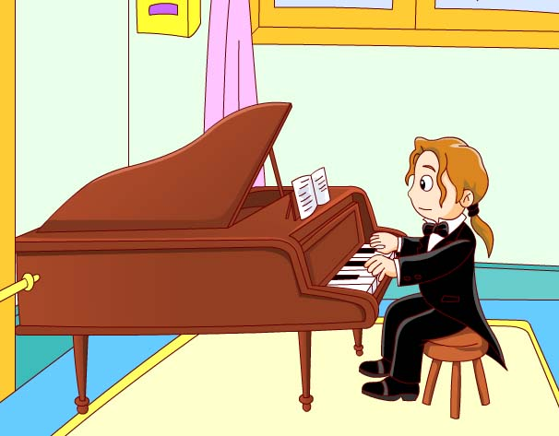

I like fishing.
We like playing chess.
He likes playing the piano.
She likes listening to music.

Slide 4
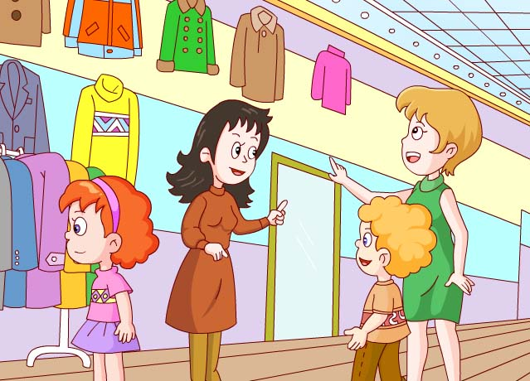
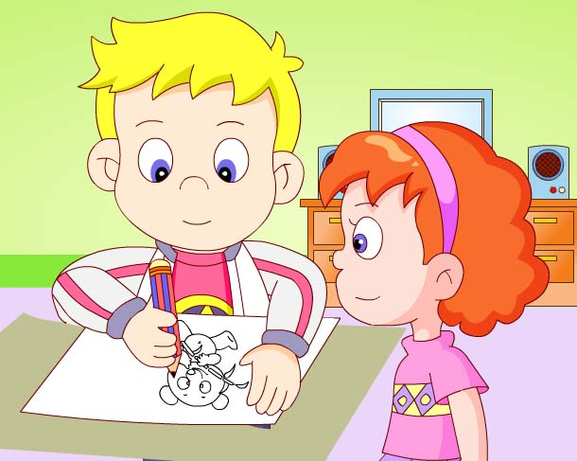
They like shopping.
He likes drawing.

Slide 5
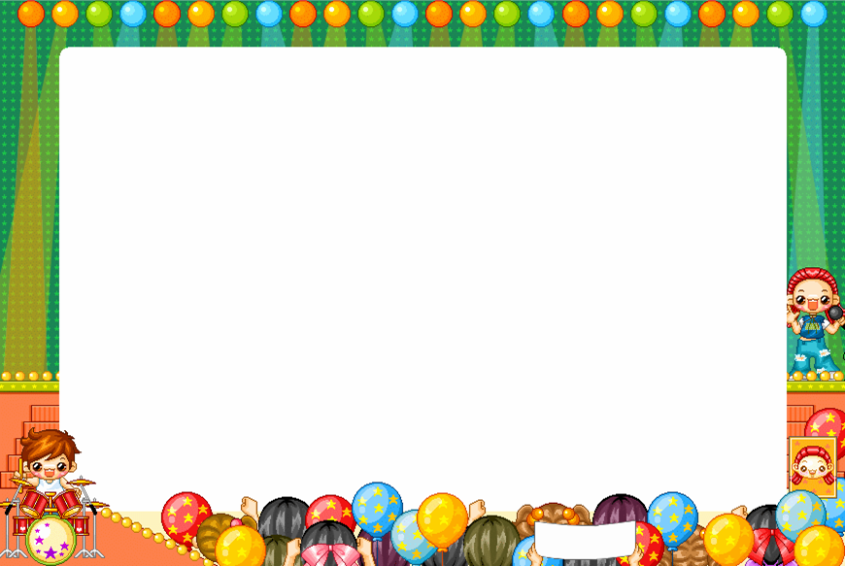
like + doing 表示喜欢做某事。用来表达一个人的爱好、习惯。
在肯定句中，当主语是I/We/You,以及三人称复数时，结构为：like doing
当主语是第三人称单数时， 结构为：likes doing.
I
We
You
They
e.g.
like reading.
He /She /It
likes eating chips.

Slide 6


I don’t like playing football.
She doesn’t like painting.

Slide 7
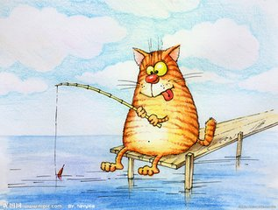
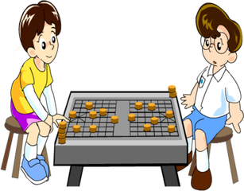
It doesn’t like fishing.
They don’t like playing chess.

Slide 8
在否定句中，当主语是I/We/You,以及三人称复数时，结构为：don’t like doing
当主语是第三人称单数时, 结构为：doesn’t like doing.
I
We
You
They
e.g.
don’t like reading.
He /She /It
doesn’t like eating chips.
Tips :does一出现，动词要还原。

Slide 9
Exercise 1
Finish the blank using like doing.
I _____________ (shop).
We_____________(sing).
She _______________(swim).
4. Tim and Mary__________(play) chess.
5. The dog_____________(eat)bones.
like shopping
like singing
likes swimming
like playing
likes eating

Slide 10
Exercise 2
Finish the blank using don’t/doesn’t like doing.
I _________________(shop).
They ________________(read).
He ___________________(swim).
4. Tim and Mary________________(play) football.
5.My father _______________(sing).
don’t like shopping
don’t like reading
doesn’t like swimming
don’t like playing
doesn’t like singing

Slide 11

Exercise 3 :
Finish the passage with like doing.
I have a lot of hobbies. I ___ _____
(dance) and____(draw). I am good at them.
But I ___ ____ ____(play)basketball . I also
____ ____ ____(shop). However(然而)，my mother ____ _____(shop). She often goes
to the shopping mall. She ___ ____ ____(fish).She says it is boring.

Slide 12
Thank you !

